Slide 1
PIP4004 - INTERNSHIP Review-4 Presentation TITLE OF THE PROJECT / WORK ASSIGNED / DOMAIN
Under the Supervision of,
Mr. SYED MOHSIN ABBASI
Assistant Professor
School of Computer Science and Engineering
Presidency University
Student Details
Name | Rohit Shivanand Mugalkhod
Roll No | 20211CSE0674
Section | 8CSE15
Name of the Program: Computer Science Engineering
Name of the HoD: Dr. Asif Mohammed
Name of the Program Project Coordinator: Mr. Jerrin Joe Francis
Name of the School Internship/Project Coordinators: Mr. Md Ziaur Rahman / Dr. Sampath A K

Slide 2
Content
About Company or Organization
Working domain or the technology
About your team and reporting Manager
Challenges Faced in Internship
Objectives of the work
Literature Review
Proposed System
Problem Statement
System Requirements
Advantages of Proposed System/Work
Internship Roadmap
Github Link

Slide 3
About Company or Organization
Company Name: Datazymes
Industry: Pharmaceutical and Healthcare Analytics
Overview:
Datazymes is a company specializing in data-driven solutions for the pharmaceutical industry.
It provides technology-based analytics, AI-powered automation, and digital transformation services to improve pharma operations.
Clients include Merck, AbbVie, and others.

Slide 4
Working domain or the technology
Domain:
Product Development.
Technology Stack:
Frontend: Vue.js, React
Backend: .NET, Node
Architecture: MVC (Model-View-Controller)
Database: SQL Server, Postgres

Slide 5
About your team and reporting Manager
Team: Product Development Team
Reporting Manager: Shuchita Nagaraj
Team Structure:
Includes 4 software developers, 2 designers, and 1 project manager.
Regular team meetings for progress tracking.
My Role:
Working on Project Intellia.
Developing and optimizing features using .NET and Vue.js.

Slide 6
Challenges Faced in Internship
Technical Challenges:
Learning a new tech stack (Vue.js & .NET).
Understanding the existing codebase.
Project Management Challenges:
Working with MVC architecture efficiently.
Adapting to agile development practices.
Communication Challenges:
Understanding business requirements from the product team.

Slide 7
Objectives of the work
Project 1: Website Revamp
Objective: Revamp the company's website by transitioning from WordPress and PHP to a modern tech stack.
Technologies Used: React, PostgreSQL, Tailwind CSS, Express.js.
Key Features:
Rebuilt the entire website with an enhanced user interface and experience.
Implemented a responsive design using Tailwind CSS.
Migrated the database to PostgreSQL for better scalability and performance.
Hosted the revamped website on a cloud platform, ensuring high availability.

Slide 8
Objectives of the work
Project 2: Nebula AIObjective:
Develop a chatbot with integrated knowledge base and source-referencing capabilities.
Technologies Used: React, Express.js, GCP (Cloud Run), RAG pipeline.
Key Features:
Created a chatbot allowing users to interact and receive information from an integrated knowledge base.
Implemented a RAG (Retrieval-Augmented Generation) pipeline to provide accurate source references.
Managed both frontend and backend development, including authentication and authorization.

Slide 9
Objectives of the work
Project 3: Marketing MixObjective:
Build a tool to provide insights based on user-uploaded data files.
Technologies Used: React, Python, FastAPI, Gemini.
Key Features:
Users can upload data files to generate insights and recommendations.
Integrated the frontend with the backend services using FastAPI.
Utilized Gemini for advanced analytics and insights generation.

Slide 10
Literature Review
Existing Systems in Pharma Tech:
Many pharma companies rely on legacy systems for data processing.
Transition to cloud-based and AI-driven solutions is in progress.
Relevant Technologies:
Vue.js for responsive UI development.
.NET for backend logic and API handling.
MVC for structured and scalable applications.

Slide 11
Proposed System / Work
Project Intellia Overview:
A data analytics-driven product to enhance decision-making in pharma.
Provides automated insights and predictive analytics for business operations.
My Contribution:
Developing key features in Vue.js and .NET.
Debugging and optimizing existing code.
Integrating UI with backend APIs.

Slide 12
Problem Statement
Current Issues in Pharma:
Slow data processing and analytics.
Lack of automated insights for decision-making.
Inefficient integration between different data sources.
How Project Intellia Solves This:
Provides real-time data insights.
Automates business processes in pharma.
Uses modern web technologies for performance improvements.

Slide 13
System Requirements
Hardware Requirements:
Minimum 8GB RAM, Intel i5 processor (for local development).
Cloud-based deployment on Azure or AWS.
Software Requirements:
Frontend: Vue.js, JavaScript, HTML, CSS
Backend: .NET Core, C#
Database: SQL Server
Version Control: Git

Slide 14
Advantages of Proposed System/Work
For the Company:
Enhances efficiency in pharma analytics.
Improves decision-making through automated insights.
For Developers:
Scalable and modular MVC architecture.
Modern tech stack with Vue.js for front-end efficiency.
For End Users:
Faster and more accurate data analysis.
User-friendly and interactive UI.

Slide 15
Internship Road Map
Review 1
Understanding company processes. Learning Vue.js and .NET technologies.
Review 2
Working on features in Project Intellia.
Debugging and optimizing code.
Review 3
Working on features and fixing bugs.
Review 4
Assisting in deployment process.
Completing project documentation and final reports and presentations.

Slide 16
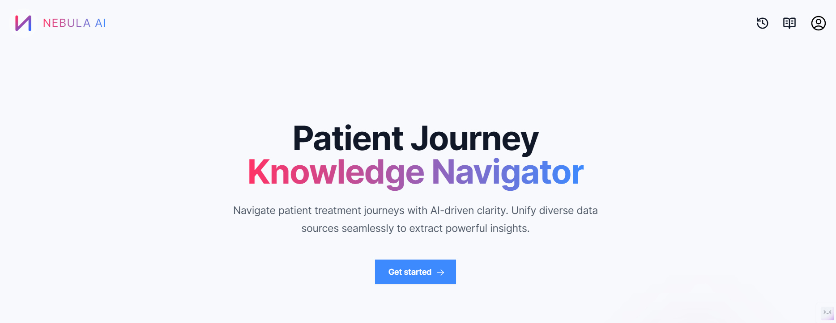
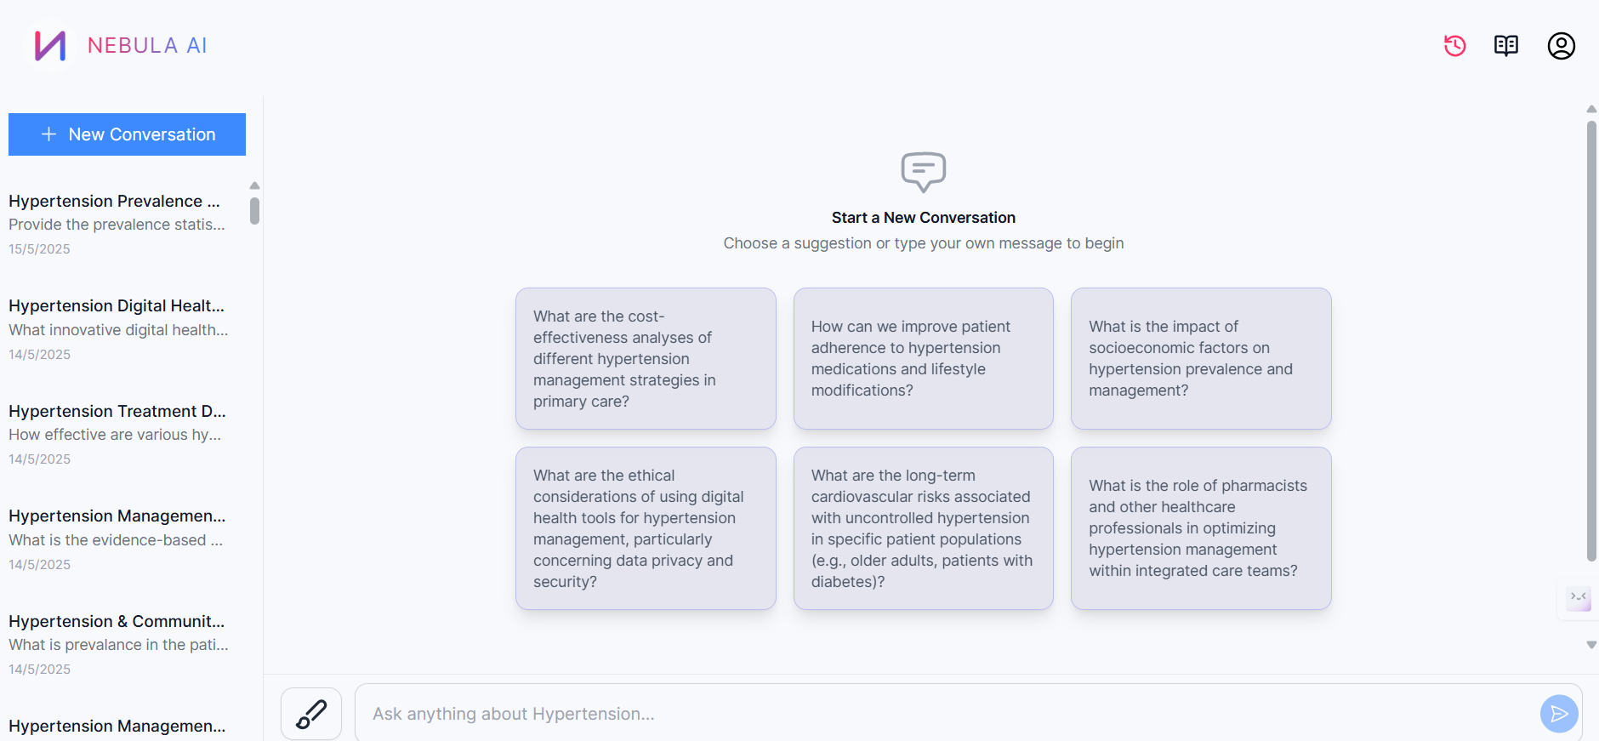
Output
Nebula AI

Slide 17
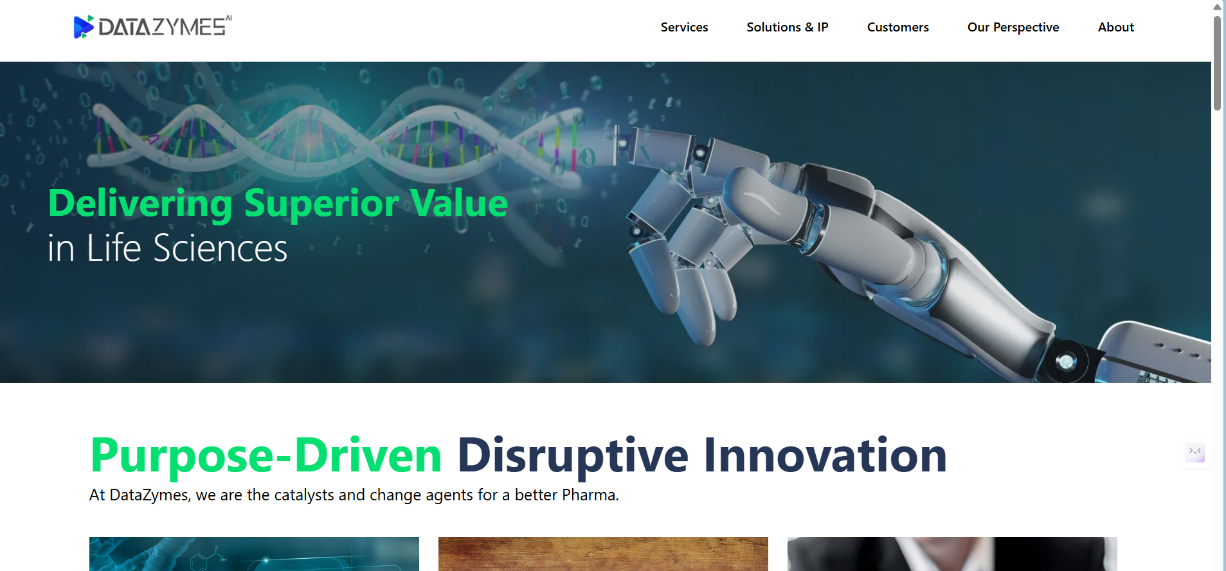
Output
DataZymes Website

Slide 18
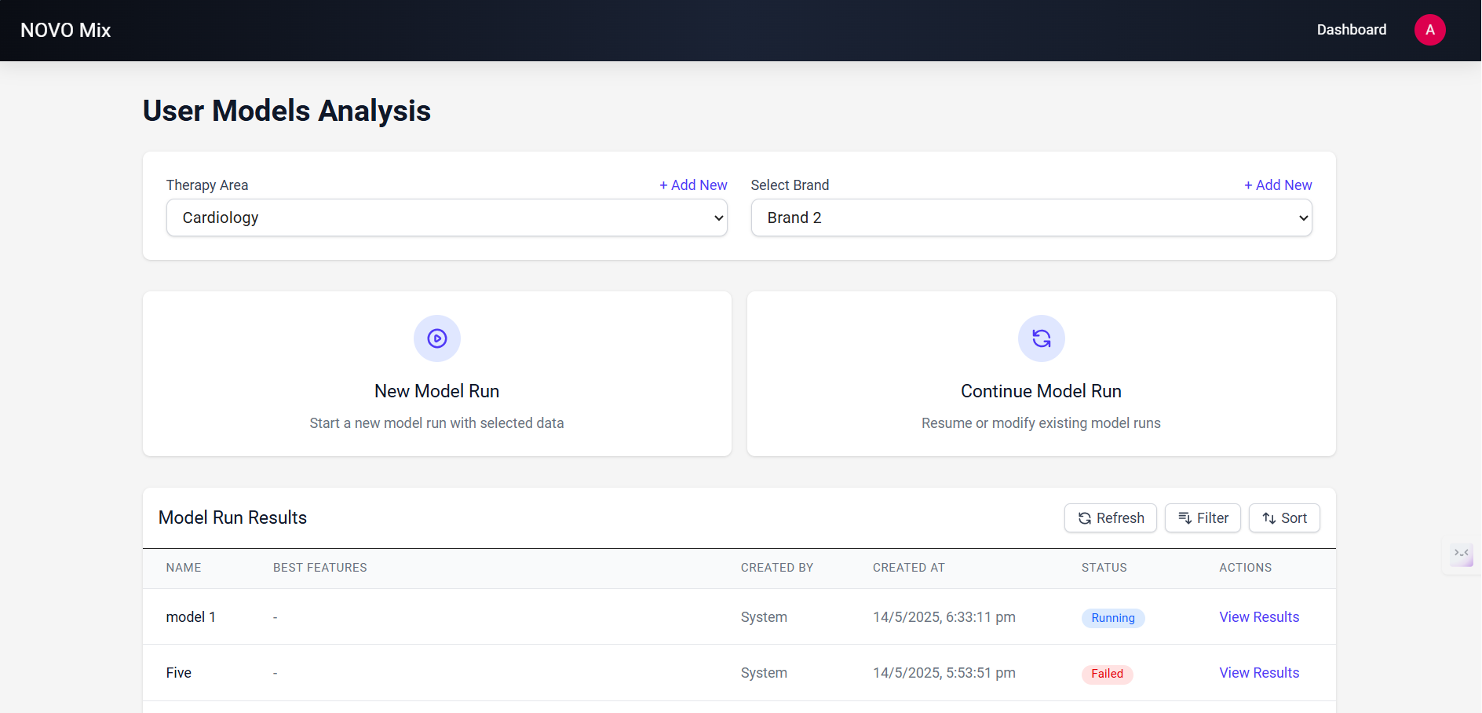
Output
NovoMix

Slide 19
Q&A

Slide 20
Thank you !!

